Slide 1
q1_2025_bitcoin_trust_fund_analysis_1
Comprehensive Analysis & Risk Assessment
May 15/2025

Slide 2
Executive Summary
Summary Assessment
Executive Summary: The Bitcoin Momentum Opportunities Fund, with an AUM of 218.7, employs a long-term Bitcoin ecosystem investment strategy with selective exposure to Bitcoin ETFs and derivatives. Our analysis indicates a Medium overall risk level with a score of 52.59. The fund's overall compliance level is Partial, scoring 44.83. Key strengths include the fund's clear focus and specialized approach, as suggested by its name and concentrated investment strategy. However, concerns arise from the high portfolio asset concentration and incomplete regulatory registrations in key jurisdictions, such as Singapore and the US, posing significant risks to the fund's operational viability and reputation.
Key Concerns
High portfolio asset concentration is listed as a very high-risk factor, indicating potential vulnerability to market fluctuations of a single asset.
The overall compliance score is 44.833333333333336 with a compliance level of Partial, highlighting significant regulatory gaps.
Incomplete regulatory registrations in key jurisdictions like Singapore and the US pose a significant risk to the fund's operational viability and reputation.
Key Strengths
The fund has a clear focus with its top holding percentage being 100%, indicating a concentrated investment strategy.
The fund's name, Bitcoin Momentum Opportunities Fund, suggests a specialized approach which could be a strength in terms of focus and expertise.
The fund has a defined risk level of Medium, which might indicate a balanced approach to investment, though this is somewhat mitigated by other concerns.

Slide 3
Fund Overview
Aum | 218.7
Management Fee | 2.2
Performance Fee | 20.0
Launch Date | January 10, 2024
Min Investment | 2 BTC or equivalent ($185,000)
Lock Up | Period: 6 months with quarterly redemptions thereafter
Security Features | Cold Storage 0x00000000219ab540356cBB839Cbe05303d7705Fa 606 BTC Multi-sig (5-of-7), Hardware
Strategy Description
Long-term Bitcoin ecosystem investment with selective exposure to Bitcoin ETFs and derivatives

Slide 4
Portfolio Allocation
Asset | Allocation
Bitcoin Direct Holdings | 74.5%
Spot Bitcoin ETFs | 14.8%
Bitcoin Mining Operations | 8.2%
Cash/Stablecoin Reserve | 2.5%
$5.2M Bitcoin Strategy HODL strategy | 80.0%
of Bitcoin holdings in cold storage Strategic trading | 15.0%
for market timing and volatility capture Derivatives | 5.0%
+21%) Sharpe Ratio | 1.7%
Maximum Drawdown | 38.0%
Average Transaction Size | 50.0%
BTC Largest Single Transaction | 10.0%
BTC (BlackRock ETF allocation) Gas Expenditure | 60.0%
BTC Network Metrics Average Transaction Fee | 14.0%
EH/s Active Addresses | 100.0%
Concentration in BTC-correlated assets Regulatory developments in key jurisdictions ETF market dynamics and potential fee compression Spot vs. futures price convergence Suggested Allocation | 5.0%

Slide 5
Risk Assessment Overview
Risk Assessment
The crypto fund has a medium overall risk level. The primary risk exposures are Operational Risk, Concentration Risk, and Regulatory Risk, with scores of 8.5, 10, and 7.0, respectively. These risks are significant due to factors such as the lack of a clear technical lead, limited multi-sig usage, and high portfolio asset concentration. The fund's high concentration in a few assets and limited liquid reserves also contribute to these risks, highlighting the potential for significant losses if these factors are not addressed.
Risk Component | Score
Market Risk | 3.7
Smart Contract Risk | 5.0
Regulatory Risk | 7.0
Liquidity Risk | 0.0
Operational Risk | 8.5
Concentration Risk | 10.0

Slide 6
Compliance Overview
Overall Compliance
Partial (44.8/100)
Compliance Assessment
The crypto fund has a partial compliance level with an overall score of 44.83. Its KYC/AML framework has a coverage score of 32.78, indicating some gaps in procedures, particularly in Singapore and the US. The fund has registrations mentioned in Singapore, the US, and EU, but these are not confirmed. Significant compliance gaps include incomplete regulatory registrations in these jurisdictions and missing KYC/AML procedures. Notably, the fund lacks comprehensive KYC/AML procedures compliant with local requirements in Singapore and the US, such as risk-based approaches and customer identification measures.
Compliance Overview
Relevant Jurisdictions:
Singapore, US, EU
KYC/AML Coverage:
32.8% Coverage

Slide 7
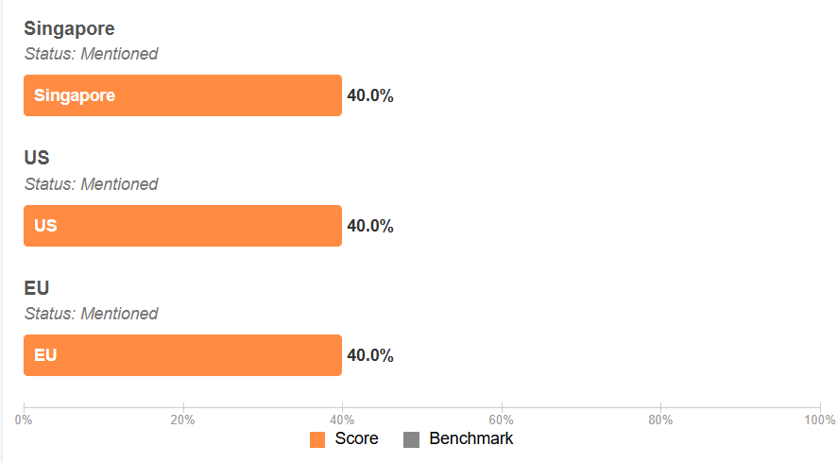
Regulatory Status by Jurisdiction

Slide 8
Identified Compliance Gaps
• Incomplete regulatory registration in Singapore
• Incomplete regulatory registration in US
• Incomplete regulatory registration in EU
• Missing KYC/AML procedures for Singapore: Risk-based approach, CDD measures
• Missing KYC/AML procedures for US: SAR filing, KYC verification, Customer identification
• Missing KYC/AML procedures for EU: UBO registry, KYC/CDD procedures, PEP screening
• Potential securities compliance gap for token offerings in US market

Slide 9
Conclusion & Overall Assessment
Overall Assessment:
The Bitcoin Momentum Opportunities Fund presents a medium risk level and partial compliance level. Its most significant strength is its clear and concentrated investment strategy, while its most significant concern is the high portfolio asset concentration. The fund's overall profile raises caution due to significant regulatory gaps and high-risk factors. In conclusion, the Bitcoin Momentum Opportunities Fund requires caution, as its specialized approach and defined risk level are offset by notable concerns regarding asset concentration and incomplete regulatory registrations.
Risk: Medium (54.0) |

